Slide 1

CRAIGSLIST RESUME MATCHING
MGMT 59000
AUD Boilers
December 8, 2021

Slide 2


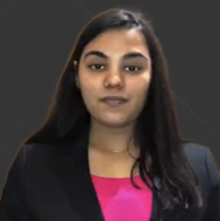


Meet the Team
ZAINAB ALJAROUDI
RYAN EGBERT
PUJA GUPTA
GAGAN PAHUJA
MRUGSHITR BANSAL

Slide 3


Background
Craigslist is an American classified advertisements website with sections devoted to jobs, housing, for sale, items wanted, services, community service, gigs, résumés, and discussion forums.
Trying to improve website traction for the ‘Resume’ subsection on Craigslist which will lead to higher visibility and more business for the website.

Slide 4
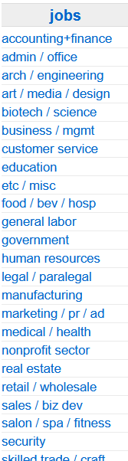
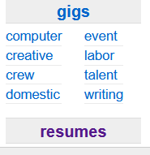
Business Analysis
Facts
Aside from the sophisticated job portals, employers and employees use Craigslist as a medium to find each other.
The jobs category on the website is properly filtered and sub-categorized while the resume category requires improvement.

Slide 5
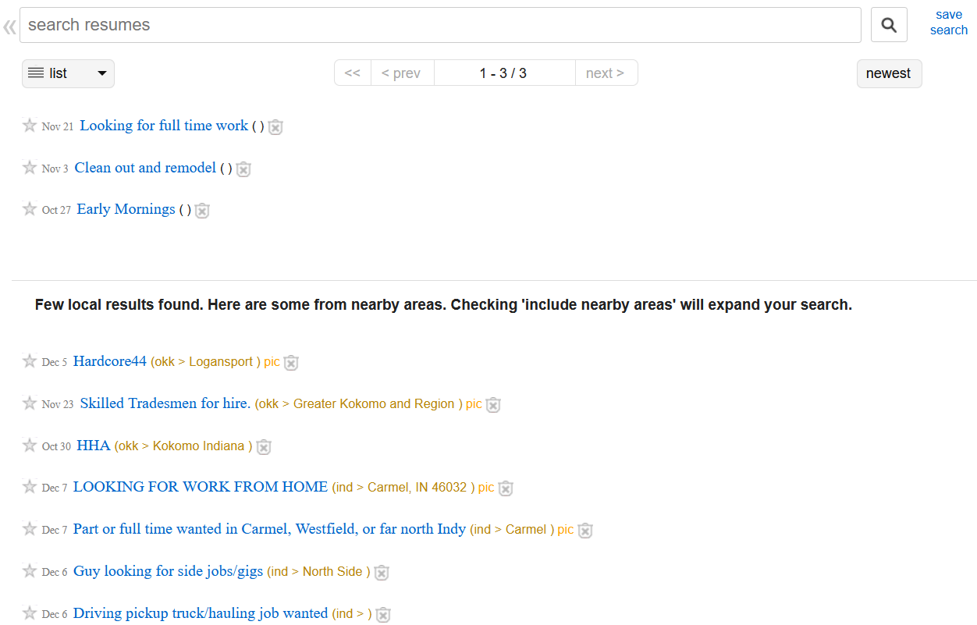
Business Analysis
Ideation
Categorize the resume category on the same filters as job category.
Match potential resumes to job listings for each category.
Match potential jobs to resume listings in the categories output in ideation part 1

Slide 6
Business Analysis
Business Objective
Improvement on the categorization part of resumes category to increase its visibility
Matching jobs and resumes to each other would create more business for the website as people will be more likely to use the said platform frequently.

Slide 7






Modelling Process
Step 1
Step 2
Step 3
Web Scraping
Dimension Reduction
Word Frequency Normalization
Step 4
Step 5
Step 6
Classification Models
Validation
Text Similarity Analysis
Icons from Freepik, Smashicons, Eucalyp

Slide 8
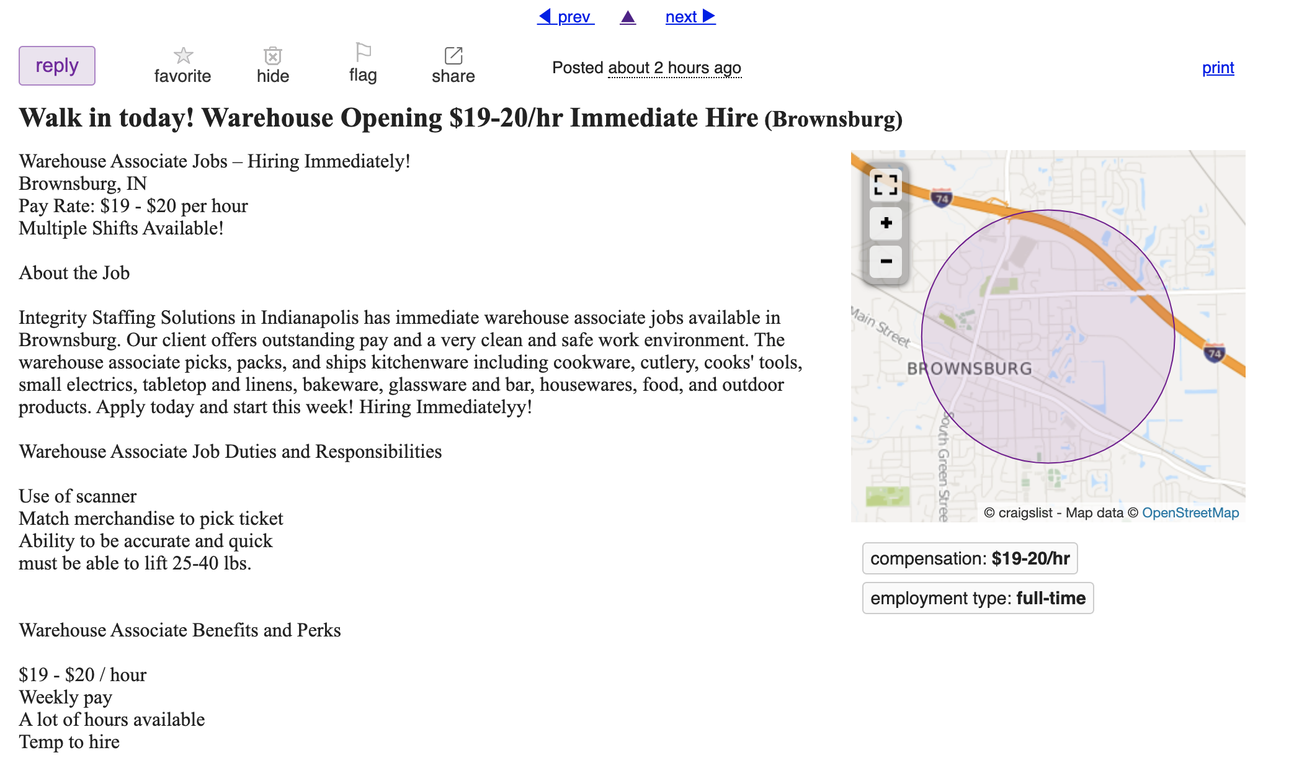
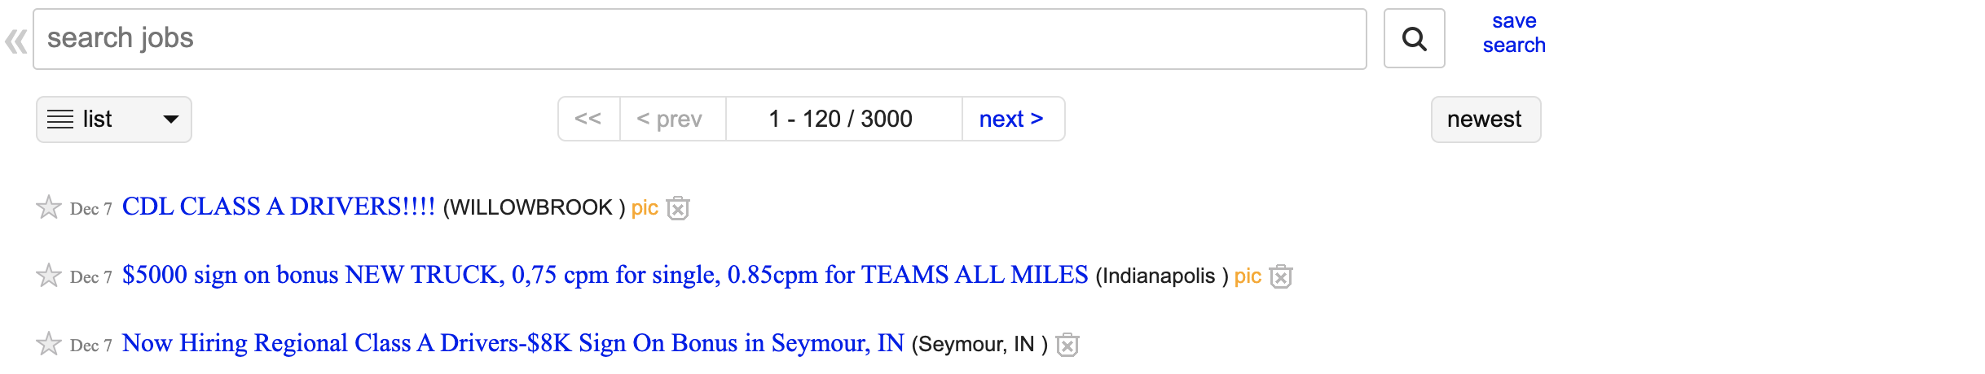
Data Analysis
Step 1 - Scraping

Slide 9
Data Analysis
Step 2 – Dimension Reduction
which
ME
or
AND

Slide 10
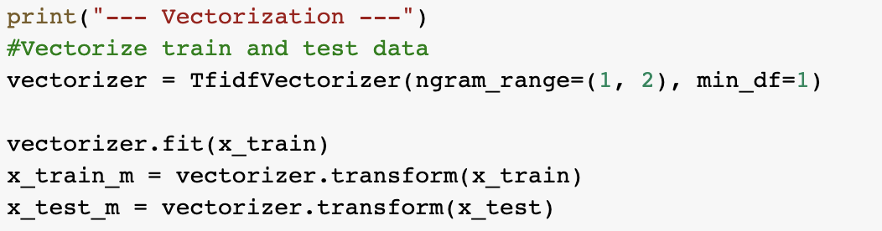
Data Analysis
Step 3 – Normalization

Slide 11
Data Analysis
Step 4 – Classification Models
Naïve Bayes
57.98%
SVM
78.93%
Decision Tree
72.5%
Random Forest
71.9%
ANN
64.76%
(never converged due to low amount of data)

Slide 12
Data Analysis
Training Data (2799 Posts)
Transportation
General Labor
Hospitality
Skilled Trades/Artisan
Manufacturing
Sales

Slide 13
Data Analysis
Resumes Data (255 Posts)
General Labor
Hospitality
Transportation
Skilled Trades/Artisan
Healthcare
Sales

Slide 14
Transportation
Step 5 – Validation
Owner operator of 16ft box truck (Illinois) I am in search of a company with consistent work for a 16ft box truck as an owner operator. 2yrs experience with class A OTR tractor trailer. Also have 2+ yrs of 16-26 ft box truck doing deliveries in all of the city of Chicago and surrounding suburbs. If you have any opportunities or any questions please contact me at show contact info . Will be able to start ASAP just waiting on the right opportunity.

Slide 15
Data Analysis
Classification
Driver Job Wanted (Chicago) CDL-Class-B Looking for Small Truck Delivery work Prefer Days Thanks Jeff show contact info
Transportation
Private Chef/Executive Chef (Lakeview) Private chef available to cook in your home.
Food Beverages
quality tech control (west burbs) Manufacturing with metal and plastics. CMM, GD&T.
Social Media Marketer (Chicago) Hi! My name is Alexyss Rubjerg and I am a social media marketer! I graduated with a business degree which really jump-started my drive. However, my childhood dream was always to own multiple businesses so I guess I should credit that. I absolutely love...
Sales
Manufacturing

Slide 16
Data Analysis
Classification
Accounting & Bookkeeping Retired accountant with experience in all phases of accounting and bookkeeping available for remote work.
Accounting
Caregiver,home help (Chicago) Male Caregiver looking for job 4 - 9 hours a day. I have experience more than 10 years. Car,dl,speaking English. Chicago and suburbs. Baking and cooking skills!Thanks
Healthcare
Remote role wanted (Chicago) I\'m looking a part time remote job. I currently have experience in sales, customer service and Health administration. Legit roles only no ad posting or scams!
Customer Service
Office Assistant (Waukegan/Gurnee) Seeking part time office assistant position 16-20 hours per week with no weekends. Available Mondays, Wednesdays and Fridays. Able to provide general office support as needed. Bi-lingual in English and Spanish.
Admin /Office

Slide 17

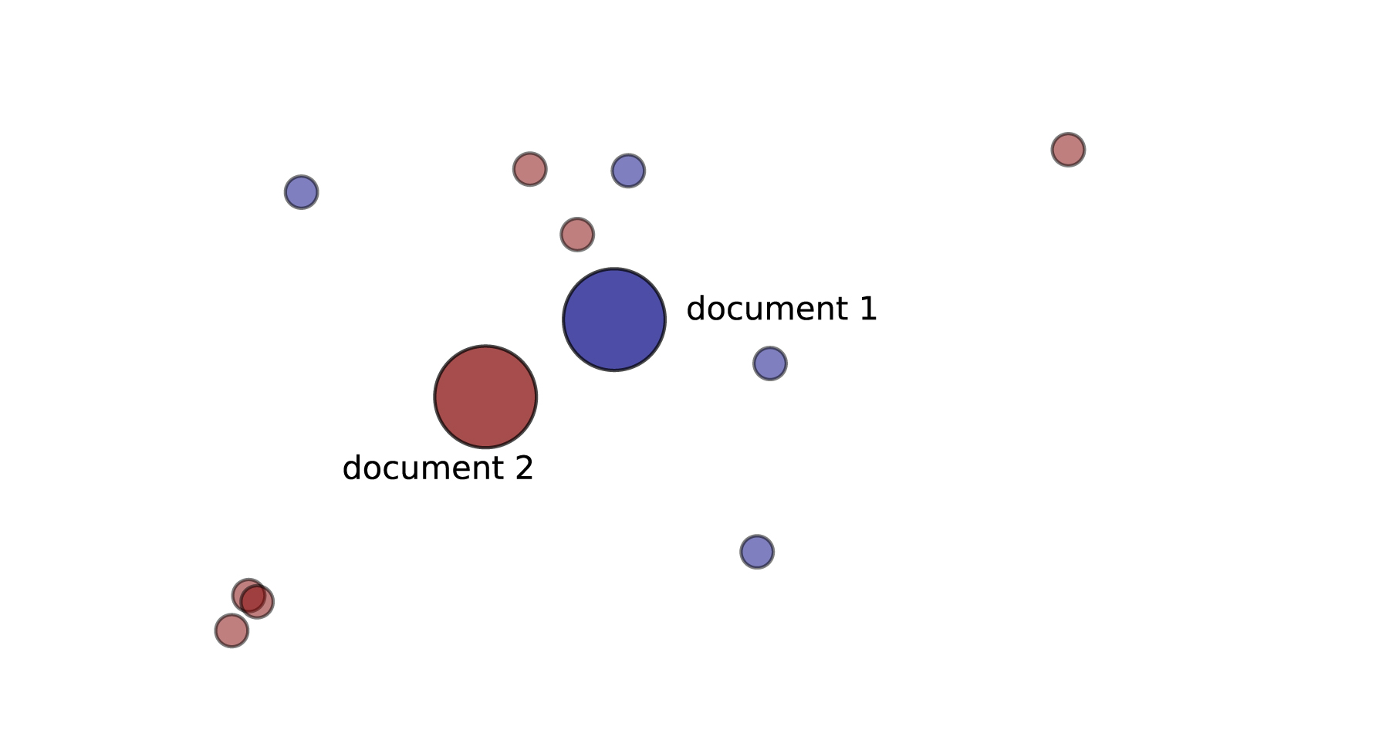
Data Analysis
Step 6- Text Similarity Analysis
Jobs
Resumes

Slide 18
Job Post
INDIVIDUAL WITH ACCOUNTING EXPERIENCE (ELK GROVE VILLAGE) LOOKING FOR SOMEONE WITH SOME SORT OF ACCOUNTING EXPERIENCE. WITH KNOWLEDGE IN QUICK BOOKS AND PURCHASING. HAVING A CPA IS NOT NECESSARY.

Slide 19

Matching Resumes
accounting/finance ACCOUNTING STAFF Advancing Accounting Expertise to Facilitate Seamless Financial Transactions
Accounting & Bookkeeping Retired accountant with experience in all phases of accounting and bookkeeping available for remote work.
A/P A/R General Accountant (Buffalo Grove) BONNIE A. BORON Buffalo Grove IL 60089 Cell: show contact info Dear Hiring Executive: As an accountant with expertise in A/P A/R and general accounting experience I am seeking new opportunities.

Slide 20

Resume
Dog sitter (Lake forest) Have worked in rescue with Fetching Tails and Almost home foundation. Worked with all breeds and sizes. My Great Dane just passed away and still have a lab. I’m a single mom abs looking to making some extra income by watching your dog at my home. I have ample space and would also be able to exercise and walk your pet. I have crates if needed. I’m flexible with price as I have a true passion for animals

Slide 21



Matching Jobs
Dog Daycare/Boarding Pack Leader (Chicago)
Dog Lover Wanted- Part and Full time positions available open availability some weekends. Able to work some holidays will be given first consideration
Dog Daycare/Boarding Pack Leader (Chicago)
Dog Lover Wanted- Part and Full time positions available open availability some weekends. Able to work some holidays will be given first consideration
Dog Daycare Handler/Overnight - Full time weekdays & weekends (Ravenswood)
Feed monitor and care for overnight dogs after business hours. Bow Wow Lounge is looking for fellow dog lovers to join our pack!.
Dog bather (Northfield) Loving Care a grooming facility is looking for a full-time Dog bather. The hours are Monday through Friday 8 am.

Slide 22
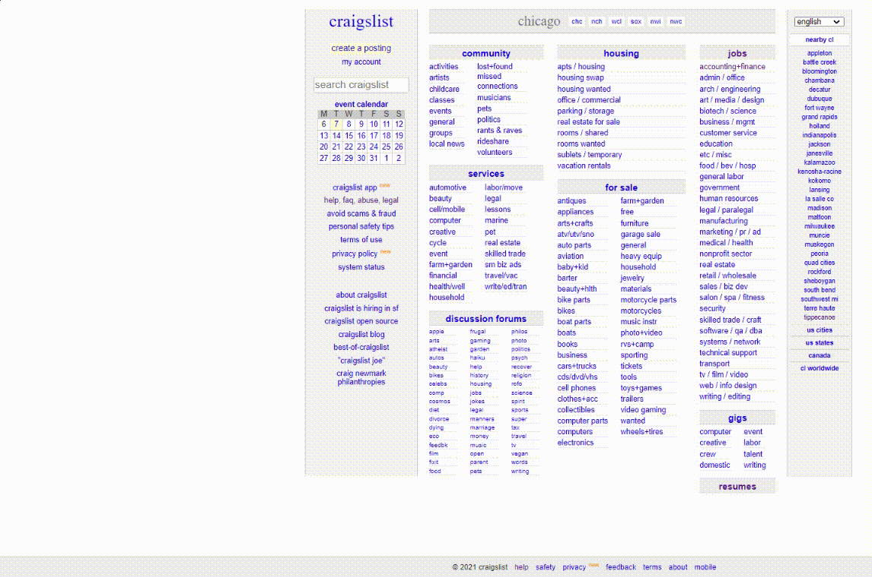

Impact
Job Seekers do not need to filter out job descriptions based on their preferred
Pay
Work schedule
Location
Qualifications
Duties
Benefits…..
And the list goes on

Slide 23

Impact
Employers do not need to filter out resumes based on applicants’
Qualifications
Availability
Location
Past experiences
Remuneration…..
And the list goes on

Slide 24
Future Scope
Gathering more data would help us to develop a deep learning model and we will be able to better predict the resume category
Manually Tag the resume so that results can be measured on similarity scores.
Use word-embedding and compare accuracy scores with TF-IDF vectorization

Slide 25
Conclusion
The testing accuracy on the job categories dataset turned out to be 78.93% based on which the categories for resumes were furbished. (Assumption being that the model predicts the categories for resumes on a +-5% of the above accuracy).
First similarity analysis produced three potential resumes for every job listing.
Second similarity analysis produced three potential job listings for every resume.
This was done to reduce the hesitancy of people looking to find jobs on Craigslist and turn the website into a more job-friendly environment.

Slide 26
Thank you

